Slide 1
Titus 1
(English Standard Version)

Slide 2
1 Paul, a servant of God and an apostle of Jesus Christ, for the sake of the faith of God’s elect and their knowledge of the truth, which accords with godliness, ² in hope of eternal life, which God, who never lies, promised before the ages began ³ and at the proper time manifested in his word through the preaching with which I have been entrusted by the command of God our Saviour;
⁴ To Titus, my true child in a common faith:
Grace and peace from God the Father and Christ Jesus our Saviour.

Slide 3
⁵ This is why I left you in Crete, so that you might put what remained into order, and appoint elders in every town as I directed you — ⁶ if anyone is above reproach, the husband of one wife, and his children are believers and not open to the charge of debauchery or insubordination. ⁷ For an overseer, as God’s steward, must be above reproach. He must not be arrogant or quick-tempered or a drunkard or violent or greedy for gain, ⁸ but hospitable, a lover of good, self-controlled, upright, holy, and disciplined. ⁹ He must hold firm to the trustworthy word as taught, so that he may be able to give instruction in sound doctrine and also to rebuke those who contradict it.

Slide 4
¹⁰ For there are many who are insubordinate, empty talkers and deceivers, especially those of the circumcision party. ¹¹ They must be silenced, since they are upsetting whole families by teaching for shameful gain what they ought not to teach. ¹² One of the Cretans, a prophet of their own, said, “Cretans are always liars, evil beasts, lazy gluttons.” ¹³ This testimony is true. Therefore rebuke them sharply, that they may be sound in the faith, ¹⁴ not devoting themselves to Jewish myths and the commands of people who turn away from the truth. ¹⁵ To the pure, all things are pure, but to the defiled and unbelieving, nothing is pure; but both their minds and their consciences are defiled. ¹⁶ They profess to know God, but they deny him by their works. They are detestable, disobedient, unfit for any good work.

Slide 5
Keeping the trustworthy faith,
the common faith
When what is promised is not what we get
Eternal life in Christ Jesus, is exactly what is promised.
Grace and forgiveness through faith. And a life of Holiness by the Holy Spirit.
No added religious rules and regulations to be added.

Slide 6
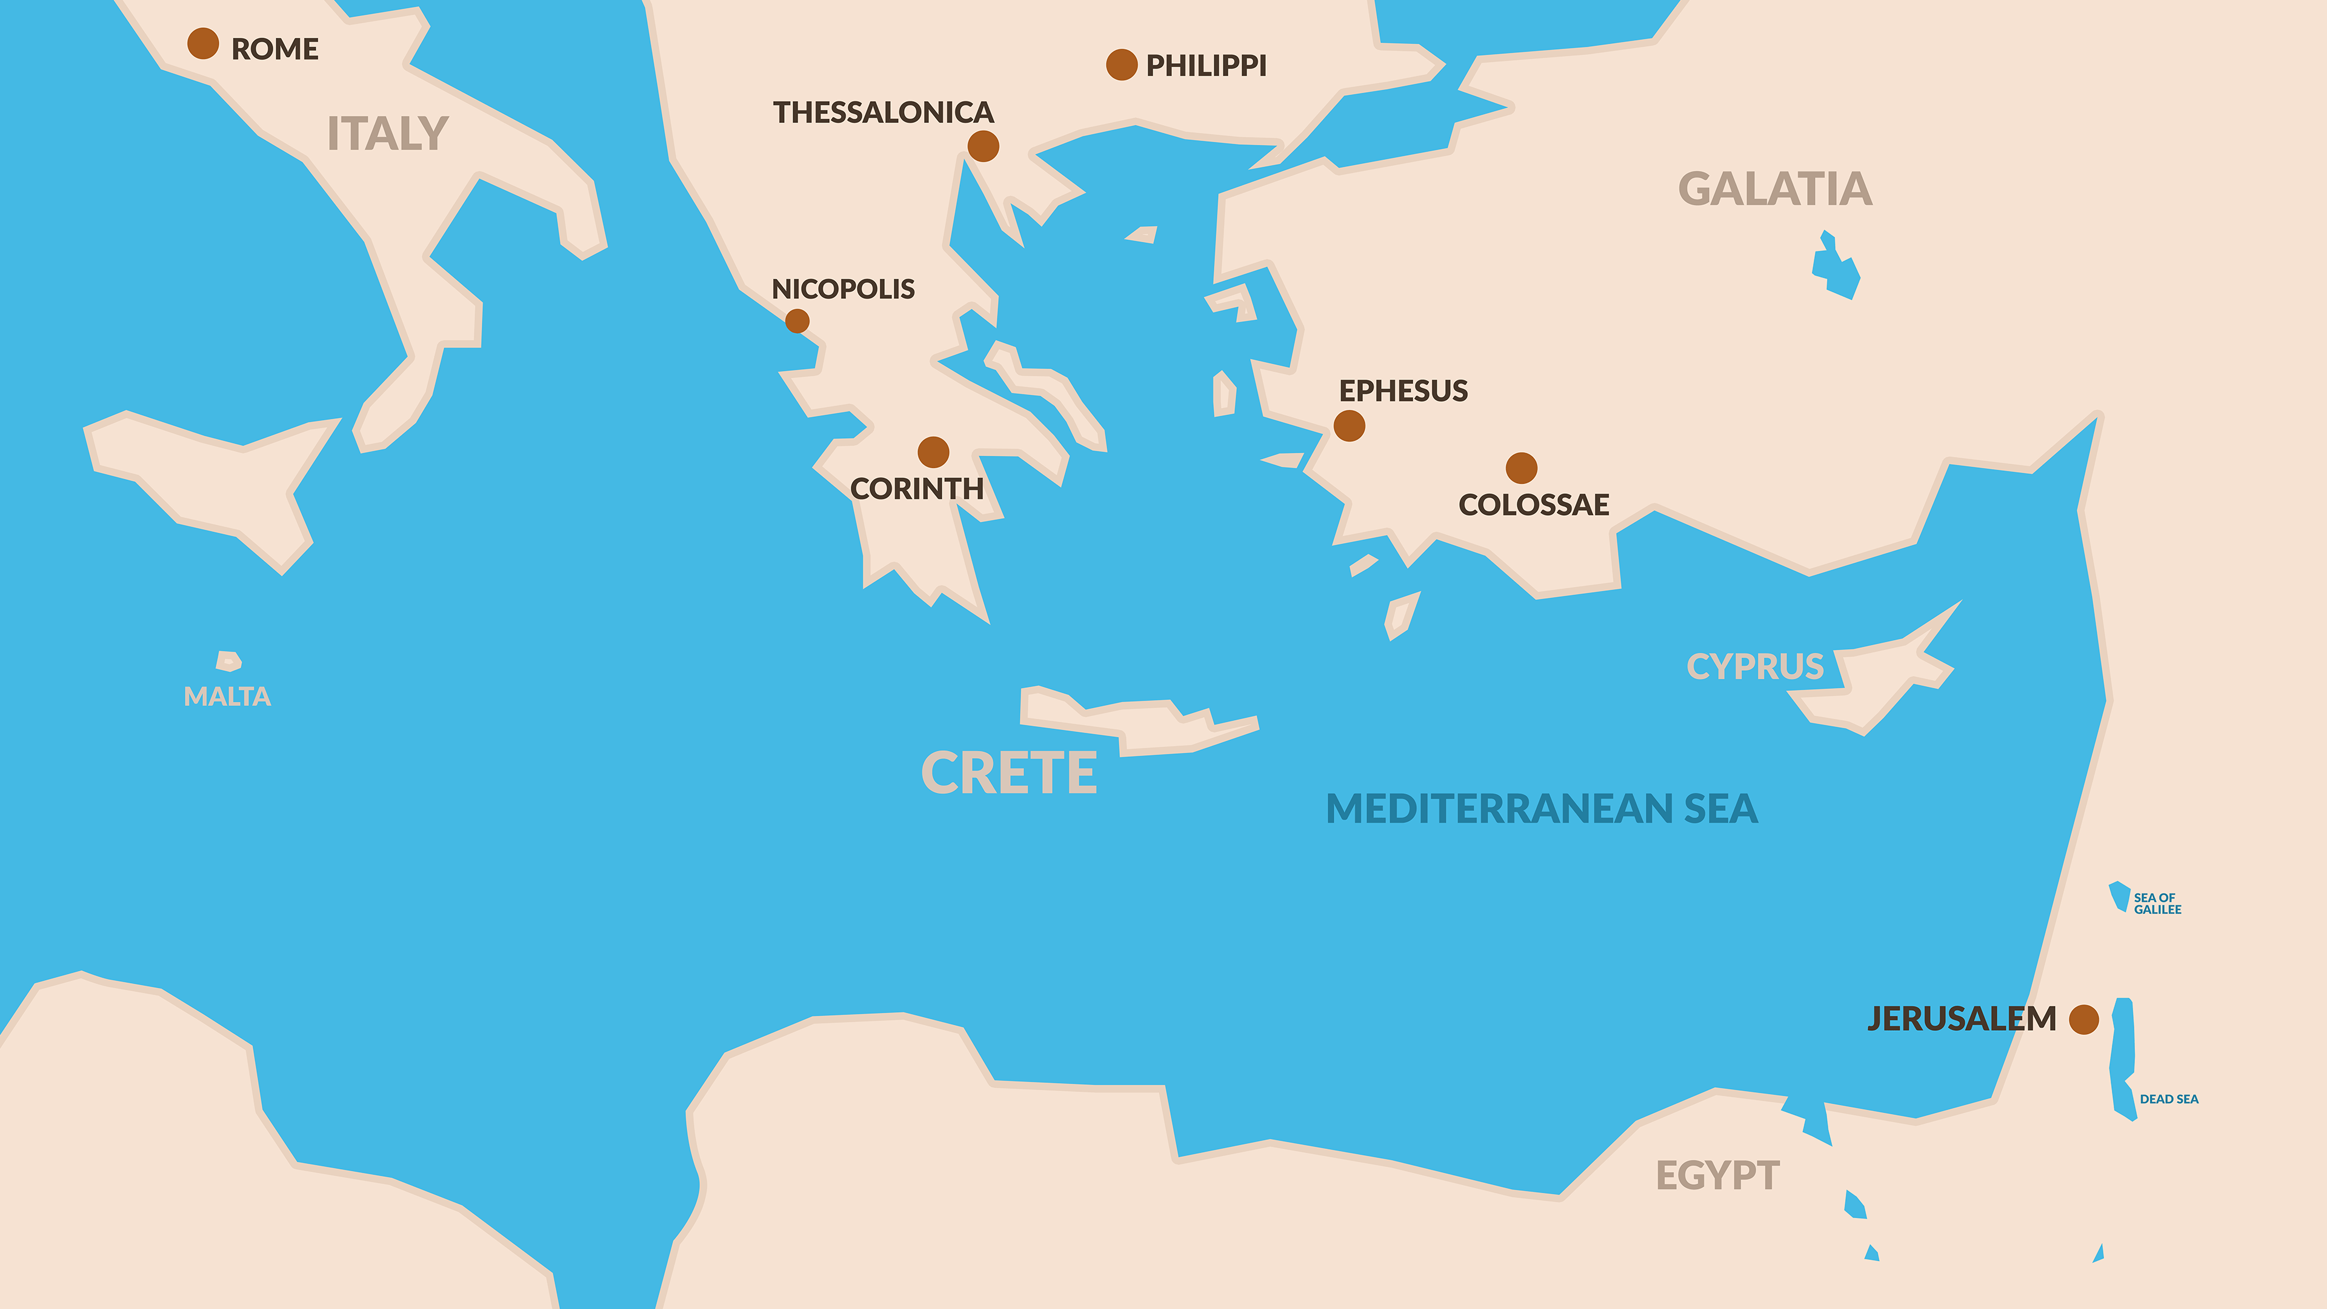
2 Timothy
1 Timothy
Titus

Slide 7
Keeping the trustworthy faith, the common faith
When what is promised is not what we get
Eternal life in Christ Jesus, is exactly what is promised.
Grace and forgiveness through faith. And a life of Holiness by the Holy Spirit.
No added religious rules and regulations to be added.
The Gospel is a great leveller –– We are all sinners in need of a saviour. Religious regulations will not save us, or make us better Christians.
The mark of being a Christian is being filled with the Holy Spirit (not religious ceremonies)
If God has made us pure, what we eat does not make us impure
The Role of an Elder: (God’s Steward)
To ensure that the teaching of the church continues to be the Gospel as promised (grace through faith in Jesus and that we continue to live out this grace in holiness)
Qualification of an Elder
Above reproach; No more than one wife; children faithful
Above reproach; not arrogant; not quick-tempered; not a drunk; not violent; not greedy;
Hospitable; a lover of good; self-controlled; upright; holy; disciplined
Hold firm to the trustworthy word
⁹ He must hold firm to the trustworthy word as taught, so that he may be able to give instruction in sound doctrine and also to rebuke those who contradict it.

